Slide 1
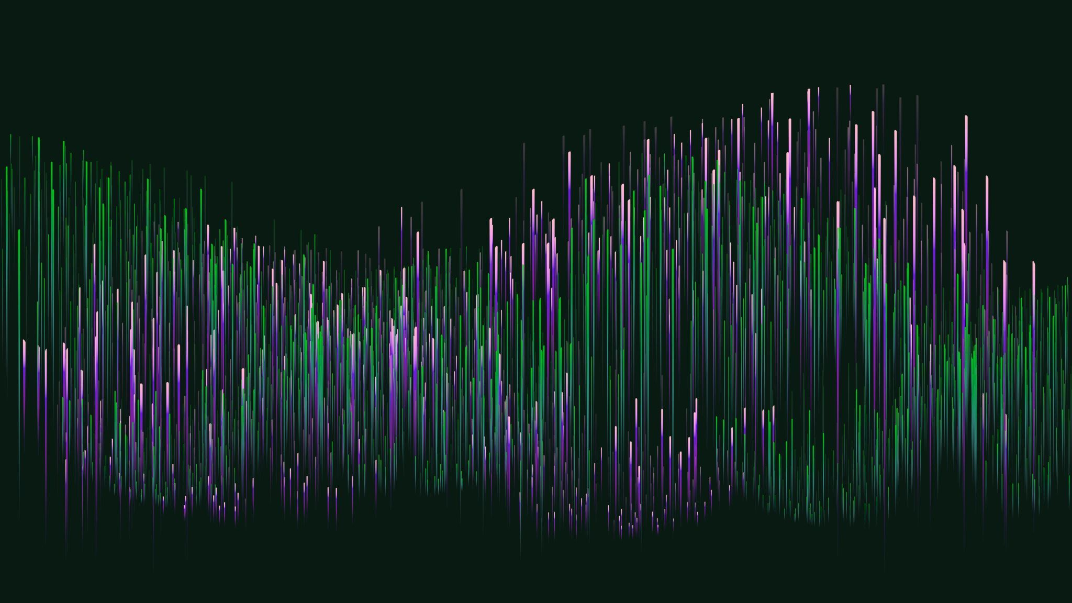
Oscillating Oxidation of Formic Acid
Electrochemical Modelling Project
By Om Mihani
4th March 2025

Slide 2
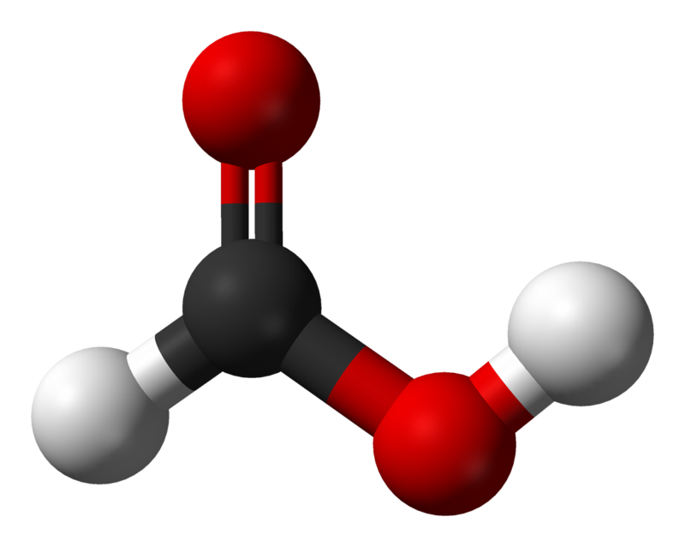
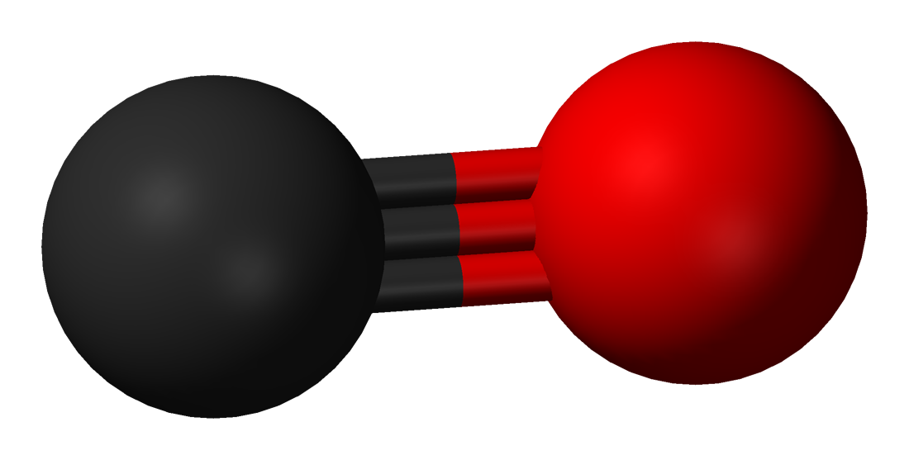
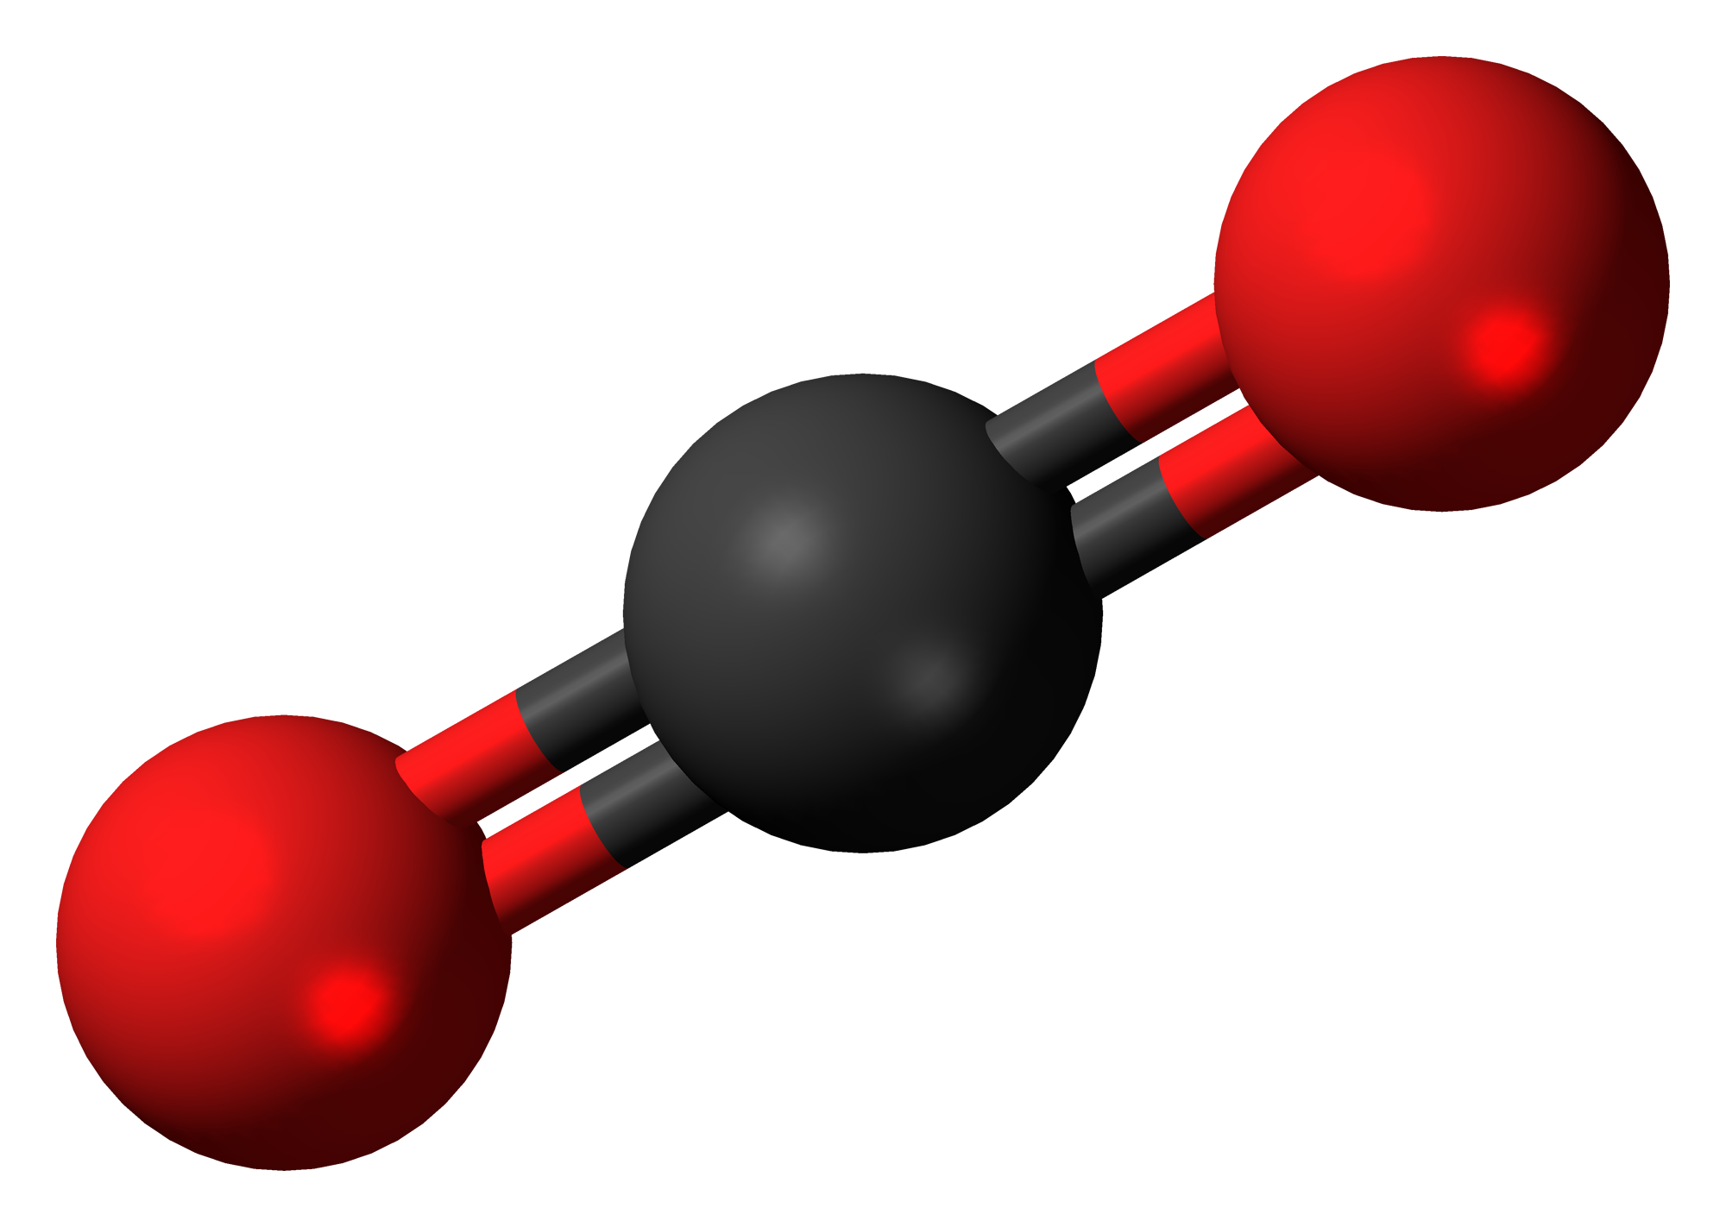
INDEX
The Phenomena
The Model
The Cases
The Solution
The Analysis
The Future
FORMIC ACID
CARBON MONOXIDE
CARBON DIOXIDE
Image Source: Wikipedia

Slide 3
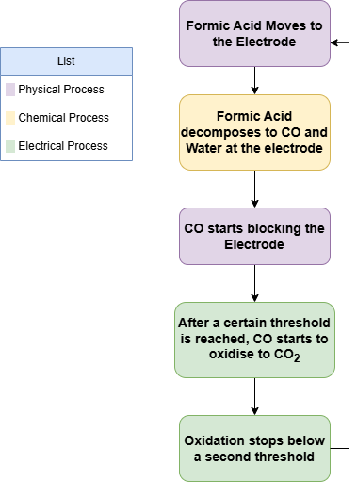
INDEX
THE PHENOMENA
FORMIC ACID ELCTROCHEMICAL OXIDATION
The Phenomena
The Model
The Cases
The Solution
The Analysis
The Future

Slide 4
INDEX
THE PHENOMENA
FORMIC ACID ELCTROCHEMICAL OXIDATION
Reactions
The Phenomena
The Model
The Cases
The Solution
The Analysis
The Future
HCOOH ⇄ CO (adsorbed) + H₂O
CO + H₂O → CO₂ + H₂ + 2e⁻

Slide 5

INDEX
THE MODEL
BULK DIFFUSION OF FORMIC ACID
The Phenomena
The Model
The Cases
The Solution
The Analysis
The Future
Reasons:
Keeps concentration in bulk constant
Allows finite domain oscillations
Defines a length scale

Slide 6

INDEX
THE MODEL
SURFACE COVERAGE OF CO
The Phenomena
The Model
The Cases
The Solution
The Analysis
The Future

Slide 7
INDEX
THE MODEL
SURFACE COVERAGE OF CO
The Phenomena
The Model
The Cases
The Solution
The Analysis
The Future
Note:
The unit for k₁ is not sec⁻¹. It is m/s

Slide 8
INDEX
THE MODEL
SURFACE COVERAGE OF CO
The Phenomena
The Model
The Cases
The Solution
The Analysis
The Future
Note:
The unit for k₁ is not sec⁻¹. It is m/s
Reasons:
To make the LHS dimensionally consistent
To express surface reaction instead of bulk
To show dependance on availability of sites
To inculcate oxidation via electricity

Slide 9

INDEX
THE MODEL
BUTLER VOLMER KINETICS WITH A TWIST
The Phenomena
The Model
The Cases
The Solution
The Analysis
The Future
Reason:
BV kinetics can be used to model both fast and slow Electron transfer

Slide 10

INDEX
THE MODEL
BUTLER VOLMER KINETICS WITH A TWIST
The Phenomena
The Model
The Cases
The Solution
The Analysis
The Future
Reasons:
Theta denotes the dependance on surface coverage
F considers the hysteresis Function
K₂ gives the oxidation kinetics

Slide 11

INDEX
THE MODEL
BUTLER VOLMER KINETICS WITH A TWIST
The Phenomena
The Model
The Cases
The Solution
The Analysis
The Future
Note: First time ever used Hysteresis expression for Formic acid oxidation

Slide 12


INDEX
THE MODEL
BOUNDARY CONDITIONS
The Phenomena
The Model
The Cases
The Solution
The Analysis
The Future
DIRICHLET BOUNDARY
NEUMANN BOUNDARY

Slide 13

INDEX
THE MODEL
INITIAL CONDITIONS
The Phenomena
The Model
The Cases
The Solution
The Analysis
The Future

Slide 14
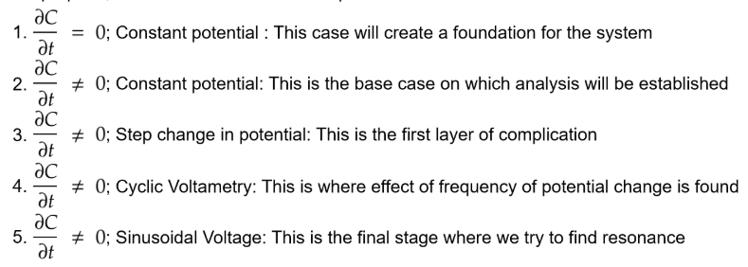
INDEX
THE CASES
5 CASES
The Phenomena
The Model
The Cases
The Solution
The Analysis
The Future

Slide 15

INDEX
THE SOLUTION
CASE 1: THE LOGIC
Assumption:
Diffusion is much faster than the surface reaction.
Test:
Taking typical values,
T_{difusion} = 0.1 s
T_{reaction} = 1 s
This allows:
PDE -> ODE
How:
The Phenomena
The Model
The Cases
The Solution
The Analysis
The Future

Slide 16
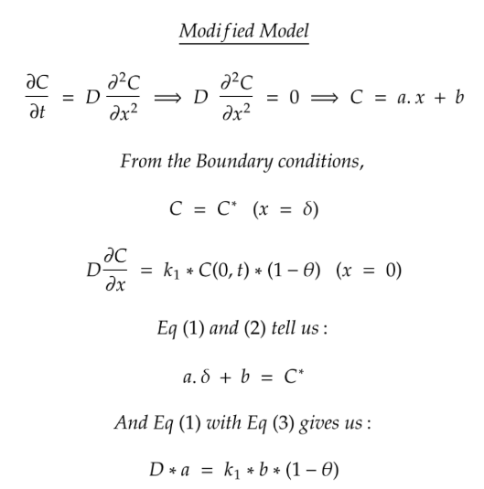
INDEX
THE SOLUTION
CASE 1: THE MATH
The Phenomena
The Model
The Cases
The Solution
The Analysis
The Future

Slide 17
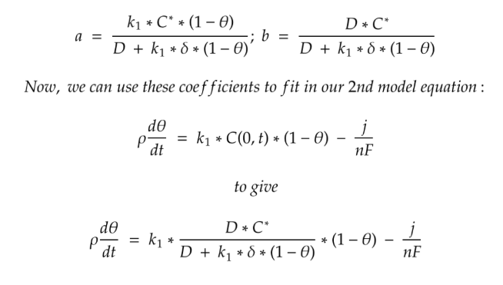
INDEX
THE SOLUTION
CASE 1: THE MATH
The Phenomena
The Model
The Cases
The Solution
The Analysis
The Future

Slide 18
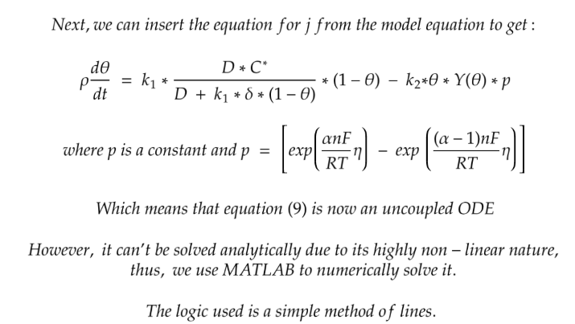
INDEX
THE SOLUTION
CASE 1: THE MATH
The Phenomena
The Model
The Cases
The Solution
The Analysis
The Future

Slide 19
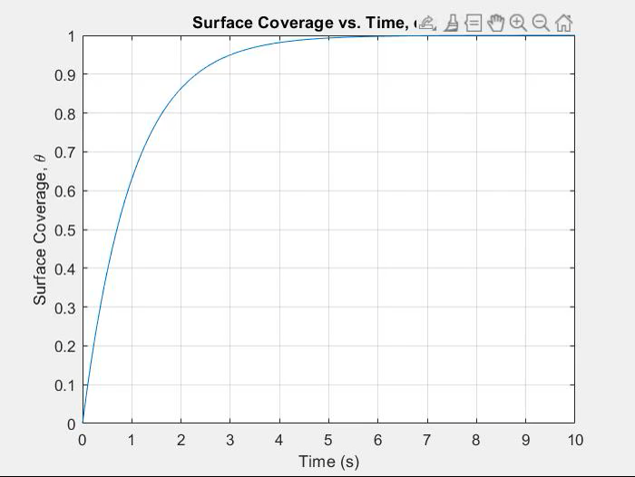
INDEX
THE SOLUTION
CASE 1: THE RESULTS
The Phenomena
The Model
The Cases
The Solution
The Analysis
The Future

Slide 20
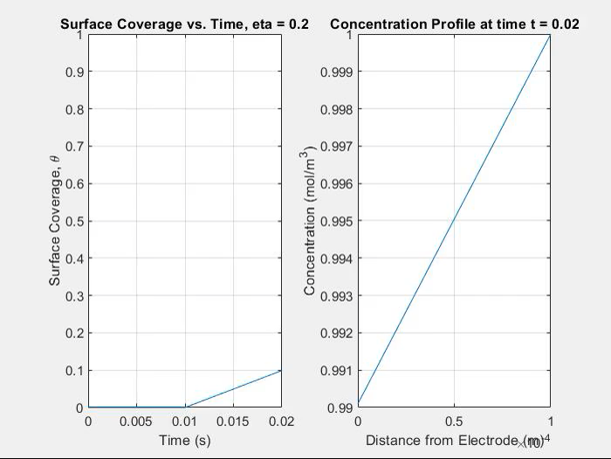
INDEX
THE SOLUTION
CASE 1: THE RESULTS
The Phenomena
The Model
The Cases
The Solution
The Analysis
The Future

Slide 21
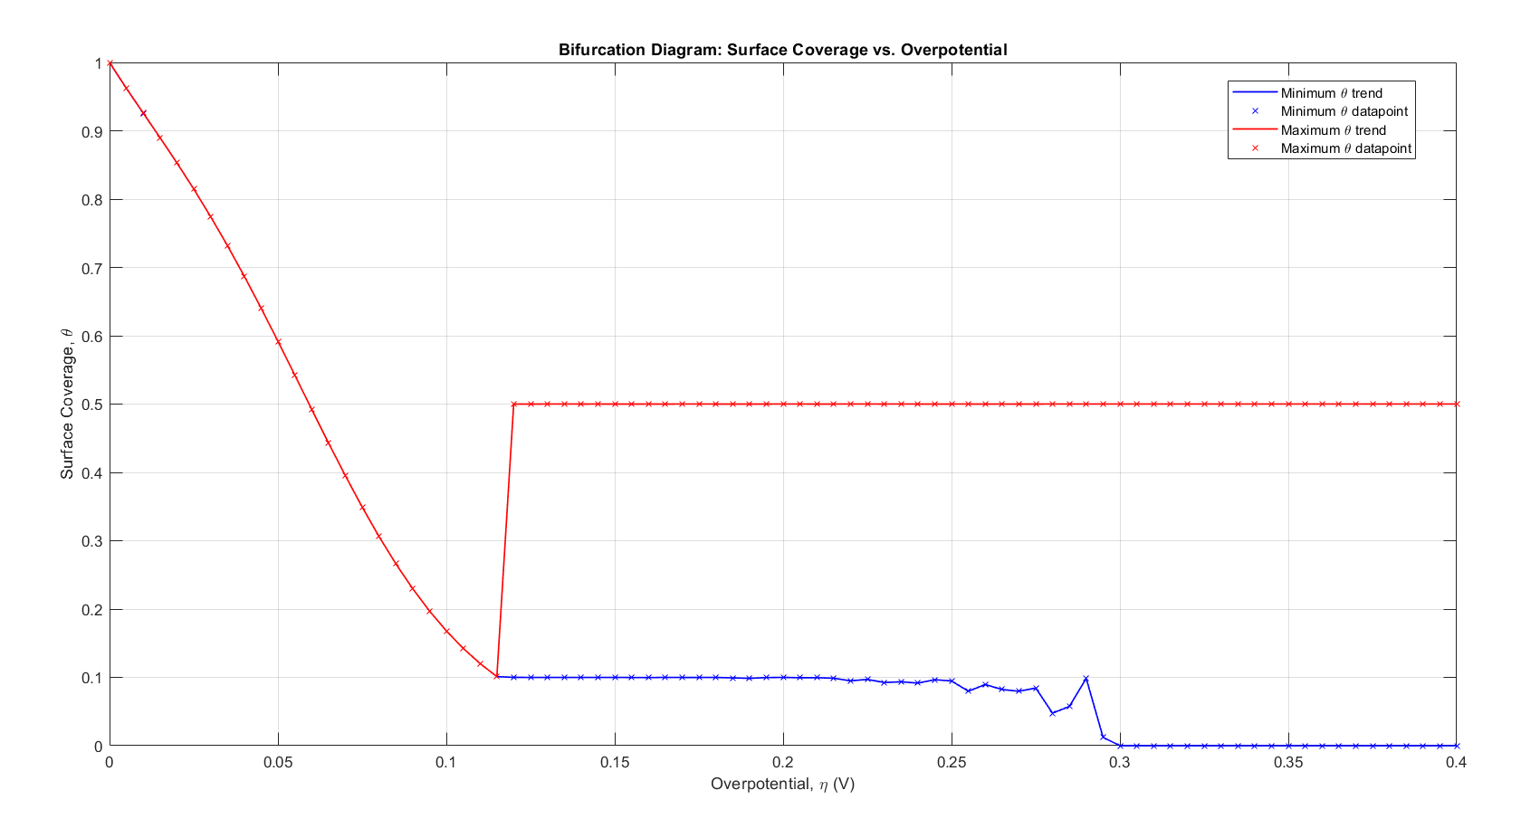
INDEX
THE ANALYSIS
CASE 1: THE ANALYSIS
The Bifurcation Diagram
The Phenomena
The Model
The Cases
The Solution
The Analysis
The Future
Food for thought: Why doesn't Surface Coverage ever exceed 0.5 while it goes below 0.1?

Slide 22
INDEX
THE ANALYSIS
CASE 1: THE ANALYSIS
The θ time profile
Note:
θ_{on} = 0.5 and θ_{off} = 0.1
5 Regimes:
Regime 1: Complete Saturation (𝜂 = 0)
Regime 2: Partial Saturation (0 < 𝜂 ⩽ 0.11)
Regime 3: Bounded Oscillations (0.12 ⩽ 𝜂 ⩽ 0.21)
Regime 4: Overshooting Oscillations (0.22 ⩽ 𝜂 < 0.3)
Regime 5: Boundary Oscillations (0.3 ⩽ 𝜂)
Note 2: As θ increases in regime 3, the frequency of oscillations increases
The Phenomena
The Model
The Cases
The Solution
The Analysis
The Future

Slide 23
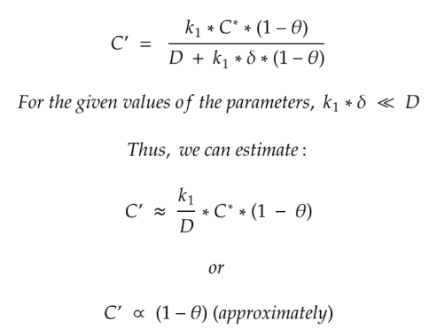
INDEX
THE ANALYSIS
CASE 1: THE ANALYSIS
The Concentration-Space profile
The Phenomena
The Model
The Cases
The Solution
The Analysis
The Future
We then consider an overshooting case (𝜂 = 0.25) and observe how concentration varies across space

Slide 24
INDEX
THE ANALYSIS
CASE 1: THE ANALYSIS
The Concentration-Space profile
The Phenomena
The Model
The Cases
The Solution
The Analysis
The Future
KEY POINT: We considered dC/dt = 0 however, it clearly changes with time.
This approximation could only be made based on the argument that Diffusion is faster than Surface deposition. However, this is still an approximation and will be dropped in subsequent cases.

Slide 25
INDEX
THE FUTURE
Solving Cases 2-5
Establishing existence of resonance
Application to analytical measurements
The Phenomena
The Model
The Cases
The Solution
The Analysis
The Future

Slide 26
CREDITS
PROFESSOR BEN JOHNSON
JIXIA LU
PERPLEXITY AI:
Used for literature Review
Help in code writing
Brain storming

